Slide 1
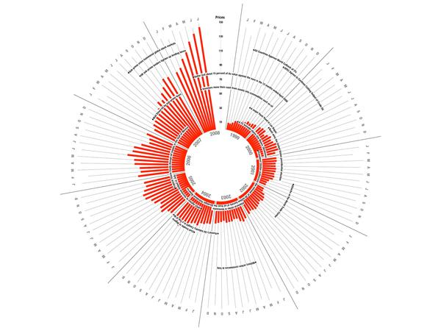
Principles of Data Visualization
MSc in Data Analytics Noel Cosgrave
Notes:
Much material in this section from http://www.fusioncharts.com/whitepapers/downloads/Principles-of-Data-Visualization.pdf

Slide 2


What Happened?
?
Image source: https://www.youtube.com/watch?v=GMGSw3GDyJQ
Image source: Clip Art Fest
Notes:
The viewer starts with a question in mind.
She then views the visualization…
…and finds an answer to the question.

Slide 3
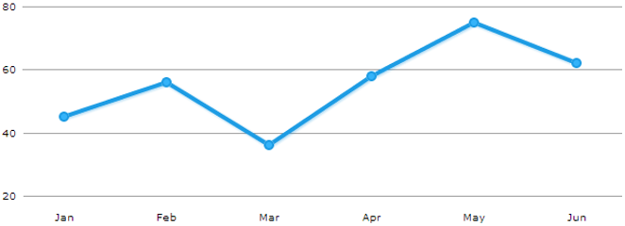
The Importance of Visualizations in Business
A visual can communicate more information than a table in a much smaller space
Image source: http://www.fusioncharts.com/whitepapers/downloads/Principles-of-Data-Visualization.pdf
Notes:
This trait of visuals makes them more effective than tables for presenting data. For example, notice the table above, and try to spot the month with the highest sales.
This data when visualized gives you the same information in a second or two.

Slide 4
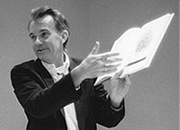
Tufte Principles of Graphical Excellence
Graphical excellence is the well-designed presentation of interesting data -- a matter of substance, of statistics, and of design.
Graphical excellence consists of complex ideas communicated with clarity, precision, and efficiency
Graphical excellence is that which gives to the viewer the greatest number of ideas in the shortest time with the least ink in the smallest space
Graphical excellence is nearly always multivariate
Graphical excellence requires telling the truth about the data.
Edward R. Tufte
Image source: https://www.goodreads.com/author/show/10775.Edward_R_Tufte
Notes:
Reference:
Edward Tufte (2001), The Visual Display of Quantitative Information.
Graphics Press USA; 2nd edition edition
ISBN-10: 0961392142

Slide 5

Two Goals in Data Visualization
Explain Data to Solve Specific Problems
Explore Large Data Sets for Better Understanding
?
Notes:
Explanatory
Exploratory

Slide 6
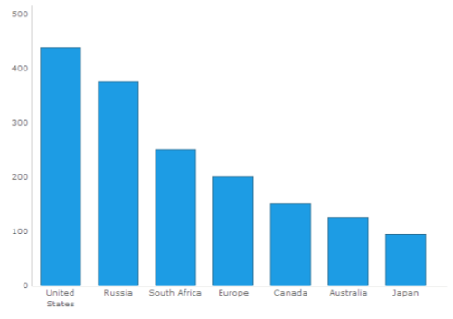
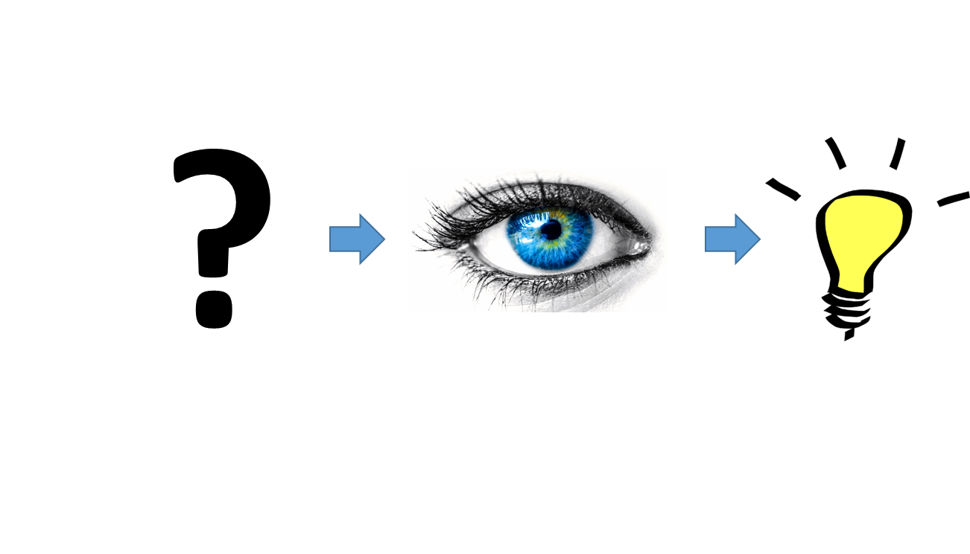
Explain Data to Solve Specific Problems
Visuals that are meant to direct the viewer along a defined path are explanatory in nature
Which country has the highest value?
Notes:
The bulk of business dashboards that we come across in day-to-day scenarios fall in this category.

Slide 7
Explanatory Visualization
This type of visualization is used in many scenarios for the following tasks:
Answer a question
How much sales did we have last quarter?
Support a decision
We need to stock more football jerseys as they were sold out on most days last week
Communicate information
Revenue is on track for this quarter
Increase efficiency
‘Technical specifications’ is the most viewed section in the product page. It should be given more visibility

Slide 8
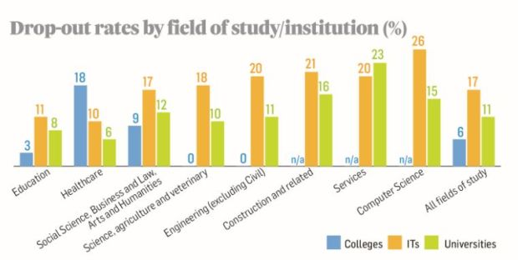
Watch out for “misleading” headlines!
Over 70% of students drop out of certain college courses (Irish Times, 9th January, 2017)
Image source: The Irish Times.
Notes:
What is Explanation here?

Slide 9
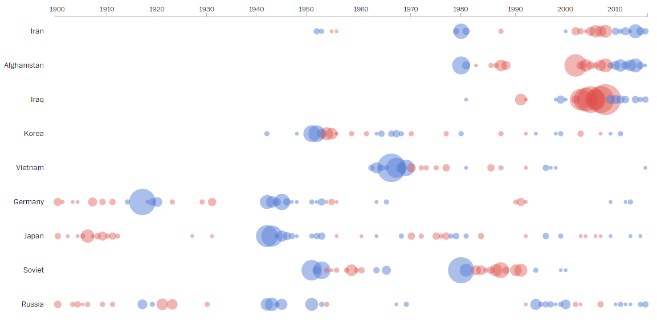
Explore Large Data Sets for Better Understanding
Exploratory visuals offer the viewer many dimensions to a data set
Inauguration Speeches
Image source: https://www.washingtonpost.com/graphics/politics/2016-sotu/language/
Notes:
Exploratory visuals offer the viewer many dimensions to a data set, or compares multiple data sets with each other.
They invite the viewer to explore the visual, ask questions along the way, and find answers to those questions
From Washington Post:
As with many words in the State of the Union addresses, many instances of country names point to contemporaneous events. This is the case with the following words, which would explain the almost isolated reference of Vietnam in the 1960s (the Vietnam War), the bubbling of “Korea” in the 1950s (the Korean War) and the rise in “Iraq,” “Iran” and “Afghanistan”mentions in recent decades.
“Names of countries get mentioned,” said Fields, “when they demand national attention, usually because of a military situation.”

Slide 10
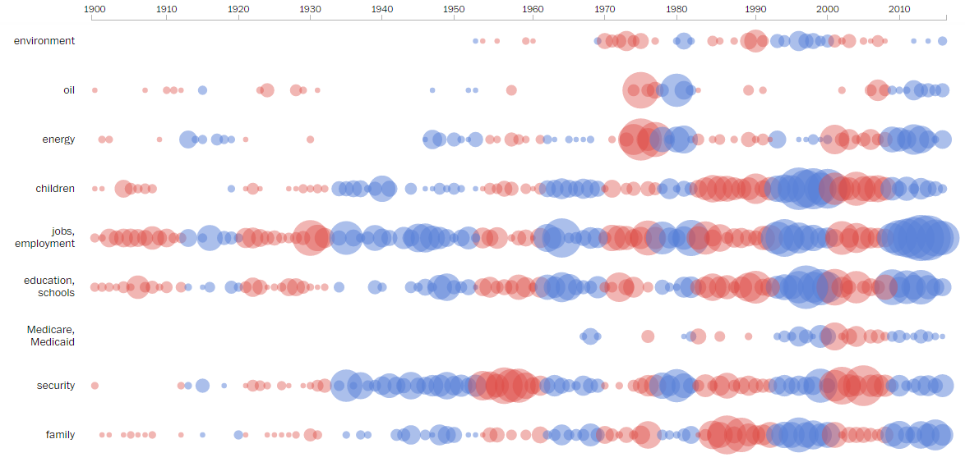
Exploratory Visualization
Issues
Image source: https://www.washingtonpost.com/graphics/politics/2016-sotu/language/
Notes:
Explore
Here, the viewer starts by familiarizing herself with the visualization, then identifies an area of interest. For example, which is the most spoken about topic and when? (Jobs from 2010). She then explores the ‘Jobs’ section of the visualization, and finds her answer. She could then move on to exploring other areas of the visualization.
Issues
Not surprisingly, the frequency of policy-oriented words rises sharply in their relevant eras and declines just as sharply thereafter.
Some connections to historical events are obvious:
The ballooning of the word “oil” in the late 1970s refers to Arab oil embargo, which pole vaulted oil to be a central domestic issue
Fluctuations with “jobs” correlate with recessions
“environment” creeps up shortly after the Environmental Protection Agency’s establishment in 1970 and the first Earth Day the same year.

Slide 11
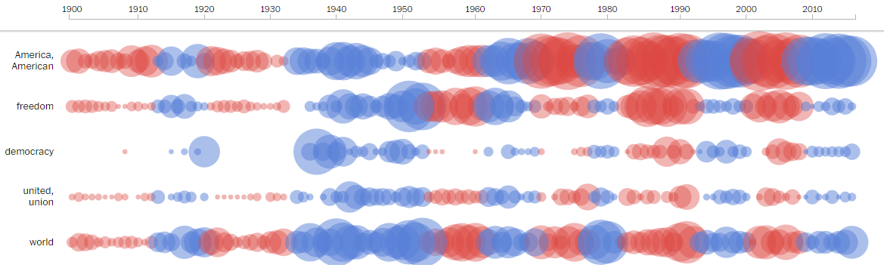
Exploratory Analysis
Viewers can find many insights from a single visualization
This type of visualization can accomplish the following tasks:
Pose new questions
Explore and discover
Nationalism
Image source: https://www.washingtonpost.com/graphics/politics/2016-sotu/language/
Notes:
Exploratory analysis can be cyclical without a specific end point. Viewers can find many insights from a single visualization, and interact with it to gain understanding rather than make a specific decision.
This type of visualization can accomplish the following tasks:
Pose new questions
Explore and discover
Though they’re not as popular as the previous category, exploratory visualizations have gained prominence in recent years with the rise of big data. The high volume of data, and varied data sets that have become common today lend themselves easily to exploratory analysis. Now that we’re aware of what makes visualizations intrinsic to business, let’s dive into the mechanics of how we process visual information. We’ll understand the role of memory in perceiving visual information, and how to apply that understanding as we work with visualizations.
Nationalism
Liberman shared a colleague’s analysis that shows words like “citizens” and “duties” have faded from presidential inaugural addresses, while words like “freedom” and “America” have surged. While it doesn’t explain the shift, he suspects that it’s likely the trend applies to both types of addresses.
Fields suspected the oscillations in “America” (and variations) shadow the popularity of “God Bless America,” which was written by Irving Berlin in 1918 and revised in 1938.

Slide 12
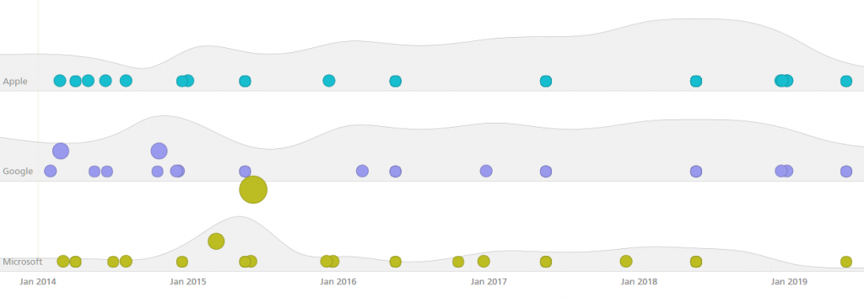
Exercise
Analyze simple visualization
Notes:
We’ll consider the following visualization from Recorded Future, a web intelligence company.
This visualization compares the mentions of Apple, Google, and Microsoft across the web. The data here is forward-looking, and considers only mentions related to the next five years.
This visualization features two chart types - An area chart, which is grayed out in the background, and a bubble chart, which is color-coded in the foreground.
The bubbles vary in size. Their size corresponds to the number of web mentions for a particular topic.

Slide 13

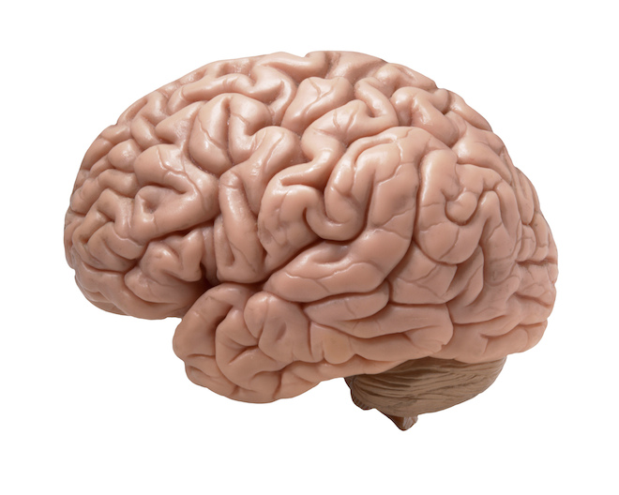
Our Eyes and the Brain
When we look at a visual, our eyes and our brain work in parallel to take in new information, and break it into small chunks
Then both the eyes and the brain process the chunks in parallel to find meaning
Images sourced from: http://www.drthomasphillips.com/eyes-windows-to-your-health/
https://www.wired.com/2014/07/everything-you-need-to-know-about-the-10-brain-myth-explained-in-60-seconds/

Slide 14
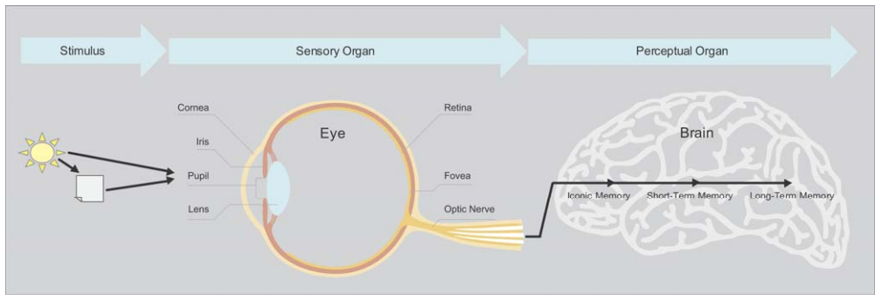
From Light to Thought (Few, 2004)
We don't actually see physical objects; we see light, either emitted by objects or reflected off of their surfaces
Visual representation of the primary components of visual perception.
Notes:
From: https://www.perceptualedge.com/articles/ie/visual_perception.pdf
This light enters our eyes through an opening in the iris called the pupil. When we focus directly on objects, the emitted or reflected light shines on a small area on the retina at the back of the eye called the fovea. The retina consists of millions of light receptors, subdivided into two basic types, rods and cones. Rods sense dim light and record what they detect in black and white. Cones sense brighter light and record what they detect in color.
Cones are further subdivided into three types, each of which detects a different range of the color spectrum: roughly blue, green, and red. The fovea is simply an area with an extremely dense collection of cones. As a result, light that shines on the fovea can be seen in extremely fine detail. We're capable of seeing up to 625 separate data points in a one-inch square area, such as a dense collection of dots in a scatter plot. Perception of visual stimuli detected by parts of the retina other than the fovea is much less detailed, but it's capable of simultaneously processing vast amounts of information throughout one's span of vision, ready to notice a point of interest that invites greater attention (for example, the peripheral approach of a speeding car), which then leads to a quick shift in one's gaze to that area of interest. Rods and cones translate what they detect into electrochemical signals and pass them on, through the optic nerve, to the brain where they can be processed. Our eyes sense visual stimuli, then our brains perceive that data, making sense of it.

Slide 15
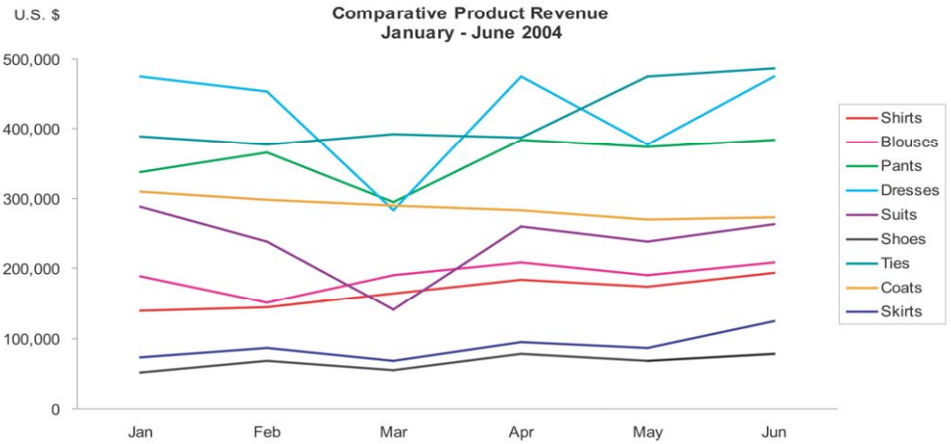
Role and Limitations of Memory
Exceeds the limits of short-term memory
There are three fundamental types of memory in the brain:
Iconic
briefly stores what the eyes see until it is either moved into short-term memory for conscious processing or is discarded as non-essential
Short-term (also known as “working memory”)
readily accessible for high-speed processing but limited in capacity
Long-term
maintains and constantly rearranges a complex network of links between memories in an effort to keep memories available and optimally useful
Notes:
From: https://www.perceptualedge.com/articles/ie/visual_perception.pdf
Just like computers, our brains use various types of storage to hold information while it's being processed and, in some cases, to store it for later use. There are three fundamental types of memory in the brain: iconic, short-term, and long-term. Iconic memory is similar to the graphics buffer of a computer, for it briefly stores what the eyes see until it is either moved into short-term memory (also known as working memory) for conscious processing or is discarded as nonessential. Short-term memory is like random access memory (RAM) in a computer: readily accessible for high-speed processing but limited in capacity. Information that's deemed worthwhile for later use is moved from short-term memory into long-term memory where it's stored and indexed in one or more ways for future retrieval, just like on a permanent storage device of a computer (for example, a hard disk). Despite a common misconception, we don't retain memories of everything we experience in life. Long-term memory is limited in its capacity, but amazing in its flexibility. It maintains and constantly rearranges a complex network of links between memories in an effort to keep memories available and optimally useful.
CHART:
Exhibits a common problem in graph design: the meaning of the nine separate data sets—represented by the nine differently colored lines—can't be concurrently held in shortterm memory. The readers are forced to shift attention back and forth between the legend and the lines of data to remind themselves over and over what each line represents. If you want someone to make sense of the graph as a whole, then you must limit the number of data components that encode distinct meanings to seven at most—and safer yet, to no more than five.

Slide 16

Eyesight and Memory Working in Parallel
Buy oranges!
Our eyes first scan the layout of the supermarket
At the same time, our brain processes the various sections of the layout, and instructs the eyes to zone in on the fruits section.
It does this by sending signals about how fruits look from memory
The eyes then break the entire scanned area into parts, and scans each part to spot the fruits section.
Notes:
Let’s say we walk into a supermarket to buy oranges. Our eyes first scan the layout of the supermarket. At the same time, our brain processes the various sections of the layout, and instructs the eyes to zone in on the fruits section. It does this by sending signals about how fruits look from memory. The eyes then break the entire scanned area into parts, and scans each part to spot the fruits section. The same process is repeated till we zero in on the oranges in the fruits section. This process of visualizing information is performed by the eyes and memory working in parallel.

Slide 17
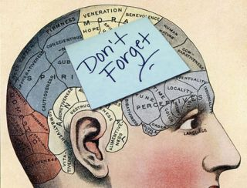
The Role of Memory in Vision
Long Term Memory
Storage of information over a long period of time
Formed by past interactions and experiences
Needs to be considered when designing the layout of a dashboard or visualization
Expectations
Image source: https://www.psychologytoday.com/blog/the-young-and-the-restless/201411/case-the-malleable-memory
Notes:
Long-term Memory
This type of memory is what makes us always expect the units to be marked off on the X and Y axes of a chart, or the date range selector at the top of a dashboard. This type of memory is formed by past interactions and experiences. It needs to be considered when designing the layout of a dashboard or visualization. There should be good reason to go contrary to long-term memory when deciding the basic structure of a dashboard or visualization.
From : http://www.human-memory.net/types_long.html
Long-term memory is, obviously enough, intended for storage of information over a long period of time. Despite our everyday impressions of forgetting, it seems likely that long-term memory actually decays very little over time, and can store a seemingly unlimited amount of information almost indefinitely. Indeed, there is some debate as to whether we actually ever “forget” anything at all, or whether it just becomes increasingly difficult to access or retrieve certain items from memory.

Slide 18
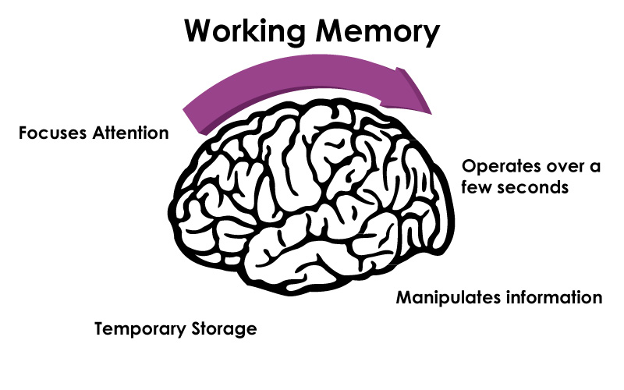
The Role of Memory in Vision
Working Memory
When we look at a chart we use our working memory to store just the information we need at the moment
“Chunking” (3 at a time)
When perceiving a complex visual, we’re constantly replacing the 3 available slots in our working memory
Goal: limit number of chunks
Image source: http://www.powerbrainrx.com
Notes:
Working Memory
When we look at a line chart, or notice a number in a dashboard, we use our working memory to store just the information we need at the moment. This type of memory breaks the entire visual into small chunks of information, in a process appropriately called ‘chunking.’ Surprisingly, for all the complexity of our brain, our working memory can hold only about 3 chunks of information at any given time.
When perceiving a complex visual, we’re constantly replacing the 3 available slots in our working memory. This is why when designing a visual or a dashboard, one of our goals is to limit the number of prominent chunks of information that we want the user to notice, and pack as much information as possible into each chunk. While we want to avoid information overload, a sound understanding of this concept can help us direct the attention of the viewer in a natural way.
Concentrate on Working Memory next few slides

Slide 19
How Memory Works
Rinadeg Oedrr
Aoccdrnig to a rscarhee at Cigdmabre Uinervtisy, it deosn’t mtetar in waht oredr the ltteers in a wrod are, the olny iprmoatnt tihng is taht the fnst and lsat ltteer be at the rghit pclae. The rset can be a taotl mses and you can sitll raed it wouthit porbelm. Tihs is bcuseae the huamn mnid deos not raed ervey lteter by istlef, but the wrod as a wlohe.”
Notes:
Ward et al discuss three types of memory: Sensory, Short-term, and long-term (page 124).
The above is an example highlighting how memory supported the quick scanning of words in a document, showing that not all letters are needed.

Slide 20
Pre-attentive Attributes
Why do our brains like looking at things in a certain way?
These things acquired together are called pre-attentive visual attributes
Pre-attentive attributes
what immediately catches our eye when we look at a visualization
perceived in less than 10 milliseconds
Notes:
Next, Let’s discuss working memory in depth. Just as any language has alphabets, which are combined to form words, the language of data visualization consists of certain basic building blocks called preattentive attributes.
Colin Ware, Director of the Data Visualization Research Lab at the University of New Hampshire, terms the basic building blocks of the visualization process as ‘Preattentive attributes.’ These attributes are what immediately catch our eye when we look at a visualization. They can be perceived in less than 10 milliseconds, even before we make a conscious effort to notice them

Slide 21
Fundamental Attributes of Sight
Even though an object as a whole might take some conscious effort to identify, the basic visual attributes that combine to make up that object are perceived without any conscious effort
Perception of these basic visual attributes is called "preattentive" processing, in contrast to the conscious part of perception, which is called "attentive" processing
“Preattentive processing” vs “Attentive processing”
(Stephen Few, 2004)
Notes:
(Few, 2004)
https://www.perceptualedge.com/articles/ie/visual_perception.pdf

Slide 22
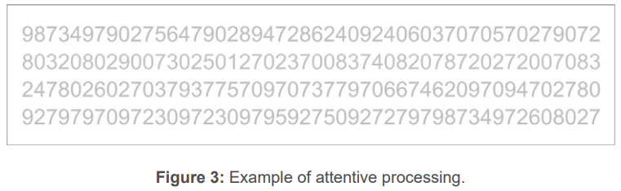
Attentive Processing
Attentive processing is done serially and is, therefore, much slower
Take a few seconds to count how many times the number "5" appears in Figure 3 above
Notes:
The visual differences between the shapes of the various numbers that appear in Figure 3 (for instance, the difference in shape between a "3" and a "5") are too complex to process preattentively.
To count all the 5's involves serial attentive processing

Slide 23
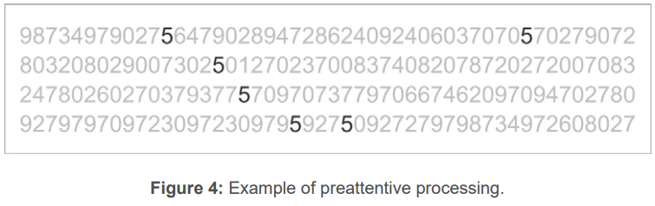
Preattentive Processing
Preattentive processing is extremely fast in that we can simultaneously perceive a large number of these basic visual attributes, called "preattentive attributes“
Take a few seconds to count how many times the number "5" appears in Figure 4 above
Notes:
This time perception was easy and immediate, because the 5's were encoded with a different preattentive visual attribute from the other numbers—in this case, a different color. Why is this important to note? Because if you want to visually encode information in a manner that can be perceived instantly and easily by your readers, you now know that you should visually encode the data using preattentive attributes, and if you want some of the data to stand out from the rest, you should encode it using different preattentive attributes.

Slide 24
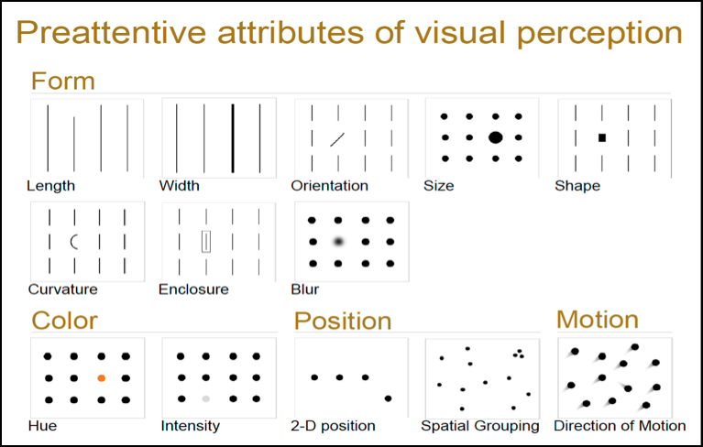
13 Most Common Pre-attentive Attributes
Precision
Image source: http://www.relationshipone.com/blog/consumable-analytics-steps-to-making-your-dashboards-delicious/
Notes:
The trick to conquering visual perception is answered by the question: why do our brains like looking at things in a certain way? These things acquired together are called pre-attentive visual attributes.
Above is a visual of the thirteen most common pre-attentive attributes. For example, with orientation, our brains are really good at distinguishing vertical lines and horizontal lines. This is why it’s effective to look at data over time as a line because we can see very quickly which way the data is going.
These attributes come into play when we analyze any visualization. Of this list, only Position, and Length can used to perceive quantitative data with precision. The other attributes are useful for perceiving other types of data such as categorical, or relational data.
Try to think what will stand out best. If you don’t know, try it out.

Slide 25
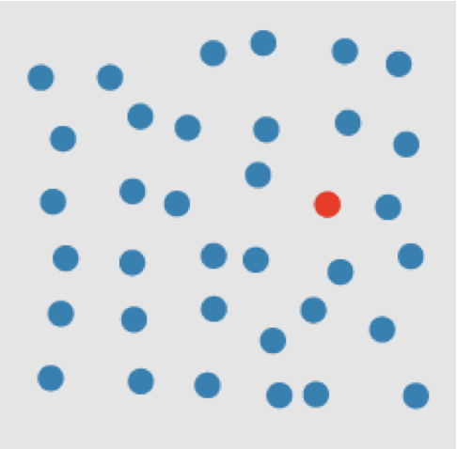


Simple example of pre-attentive task
Target is present in a sea of blue circle distractors.
Target is absent.
Image source: http://www.idvbook.com/teaching-aid/figures/chapter-3/
Notes:
This and next few slides from: Ward, M., Grinstein, G. & Keim, D. (2015) Interactive Data Visualization: Foundations, Techniques, and Applications.
An example of searching for a target red circle based on a difference in hue.
The target object has a visual property “red” that the blue distractor objects do not (all non-target objects are considered distractors). A viewer can tell at a glance whether the target is present or absent.

Slide 26


Simple example of pre-attentive task
Target is absent in a sea of red square distractors.
Target is present.
Image source: http://www.idvbook.com/teaching-aid/figures/chapter-3/
Notes:
An example of searching for a target red circle based on a difference in curvature (form).
A viewer can tell at a glance whether the target is present or absent.

Slide 27
Uniqueness
A unique visual property in the target allows it to “pop out” of a display
Target
Red
Circular
Easy to find
Image source: http://www.idvbook.com/teaching-aid/figures/chapter-3/

Slide 28
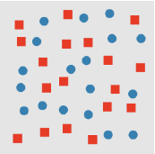
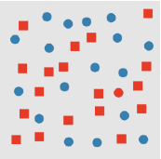
Mask Information
Not so easy to find target
Viewers must perform time-consuming search to confirm presence or absence of target
Target is absent in a sea of red square and blue circle distractors.
Target is present.

Slide 29
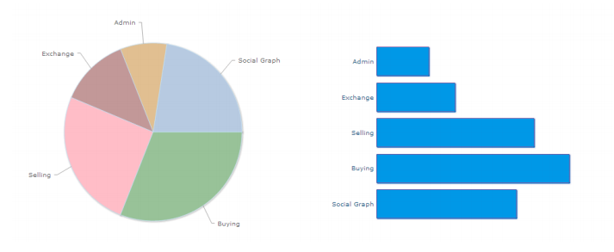
Perceive quantitative data with precision
Both the pie chart and the bar chart above show the same data
But you can’t easily tell from the pie chart which is the biggest pie
That’s more clearly visible in the bar chart as it calls on the pre-attentive attribute of length.
Notes:
Considering preattentive attributes can help when deciding which chart type to use for our data. While preattentive attributes are what we immediately identify in a visual, they aren’t the only things we notice. We go on to form patterns out of the preattentive attributes.

Slide 30
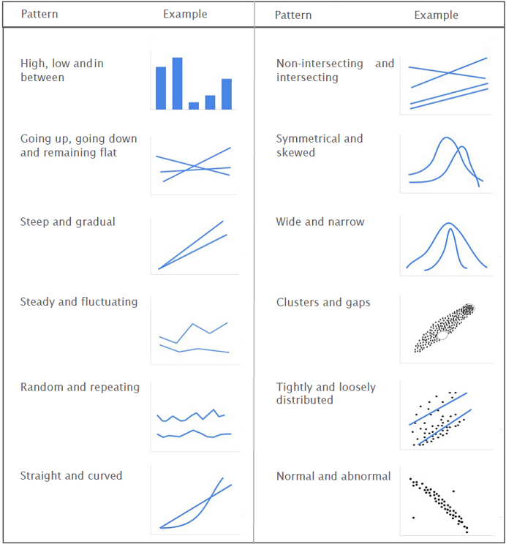
Forming Analytical Patterns Out of Pre-attentive Attributes
Basic analytical patterns that we identify when looking at a visual
Notes:
If pre-attentive attributes are the alphabets of visual language, analytical patterns are the words we form using them. We immediately identify the pre-attentive attributes in a visualization. We then combine the pre-attentive attributes to seek out analytical patterns in the visual.
We’ve seen how pre-attentive attributes and patterns enable us to process visual information. However, when crafting visualizations we often want to highlight certain patterns over others. In these cases, Gestalt’s Principles come in handy.

Slide 31




Gestalt Principles
Gestalt means "unified whole“
It refers to theories of visual perception developed by German psychologists in the 1920s
These theories attempt to describe how people tend to organize visual elements into groups or unified wholes when certain principles are applied
Notes:
Images from: http://graphicdesign.spokanefalls.edu/tutorials/process/gestaltprinciples/gestaltprinc.htm
1st image (Sunburst/Bird)
Similarity occurs when objects look similar to one another. People often perceive them as a group or pattern. he example above (containing 11 distinct objects) appears as a single unit because all of the shapes have similarity. Unity occurs because the triangular shapes at the bottom of the eagle symbol look similar to the shapes that form the sunburst.
2nd image (H)
Continuation occurs when the eye is compelled to move through one object and continue to another object. Continuation occurs in the example above, because the viewer's eye will naturally follow a line or curve. The smooth flowing crossbar of the "H" leads the eye directly to the maple leaf
3rd Image (Panda)
Closure occurs when an object is incomplete or a space is not completely enclosed. If enough of the shape is indicated, people percieve the whole by filling in the missing information. Although the panda above is not complete, enough is present for the eye to complete the shape. When the viewer's perception completes a shape, closure occurs.
4th Image (15 figures/tree)
Proximity occurs when elements are placed close together. They tend to be perceived as a group. The fifteen figures above form a unified whole (the shape of a tree) because of their proximity.

Slide 32

Gestalt Principles
Gestalt principles describe how our mind organizes individual elements into groups
We can use these principles to highlight patterns that are important, and downplay other patterns
Anomally
The figure on the far right becomes a focal point because it is dissimilar to the other shapes.
Notes:
When similarity occurs, an object can be emphasised if it is dissimilar to the others. This is called anomally.

Slide 33


Figure and Ground
The eye differentiates an object form its surrounding area. a form, silhouette, or shape is naturally perceived as figure (object), while the surrounding area is perceived as ground (background)
Balancing figure and ground can make the perceived image more clear. Using unusual figure/ground relationships can add interest and subtlety to an image
Figure
The word above is clearly perceived as figure with the surrounding white space ground.
In this image, the figure and ground relationships change as the eye perceives the form of a shade or the silhouette of a face.
This image uses complex figure/ground relationships which change upon perceiving leaves, water and tree trunk

Slide 34
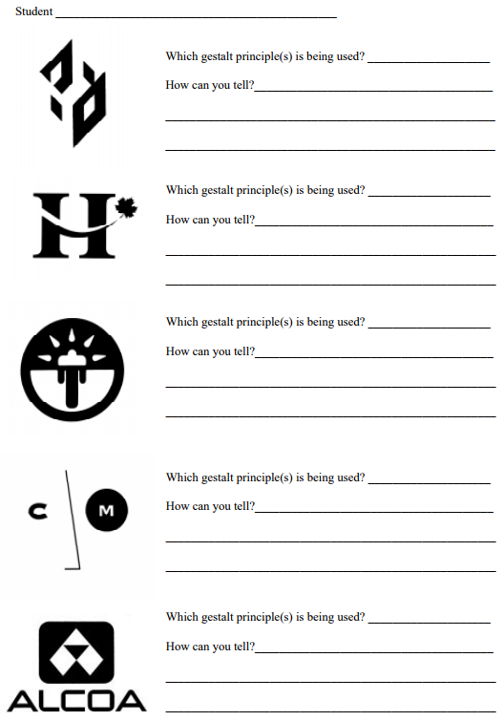
Gestalt Exercise
http://graphicdesign.spokanefalls.edu/tutorials/process/gestaltprinciples/gestalt.pdf

Slide 35
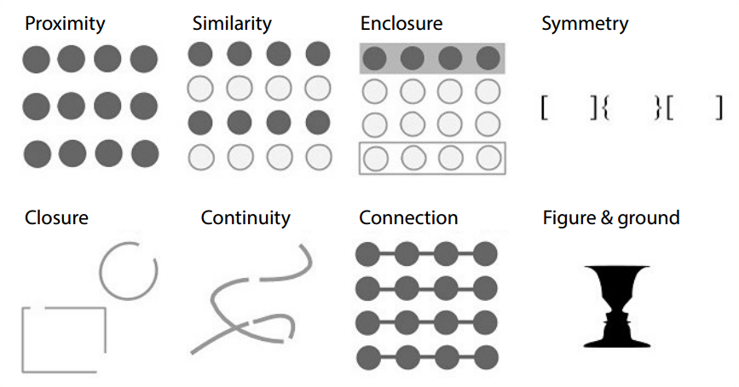
Principles of Gestalt which are relevant to visualization
Notes:
Here’s what we notice from each of the illustrations:
Proximity:
We see three rows of dots instead of four columns of dots because they are closer horizontally than vertically.
Similarity: We see similar looking objects as part of the same group.
Enclosure: We group the first four and last four dots as two rows instead of eight dots.
Closure: We automatically close the square and circle instead of seeing three disconnected paths.
Continuity: We see one continuous path instead of three arbitrary ones.
Connection: We group the connected dots as belonging to the same group.
Symmetry: We see three pairs of symmetrical brackets rather than six individual brackets.
Figure & ground: We either notice the two faces, or the vase. Whichever we notice becomes the figure, and the other the ground

Slide 36
Crafting Visualizations
These principles can help us perform many tasks such as:
Reduce the noise from charts
Choose the ideal aspect ratio
Show relationships between elements more clearly
The Gestalt principles are a powerful tool to have when crafting visualizations.

Slide 37
Exercise
Analyze simple visualization
Gestalt principles
Pre-attentive Attributes
Notes:
We’ll consider the following visualization from Recorded Future, a web intelligence company. This visualization compares the mentions of Apple, Google, and Microsoft across the web over the next five years.
This visualization features two chart types – An area chart, which is grayed out in the background, and a bubble chart, which is color-coded in the foreground.

Slide 38
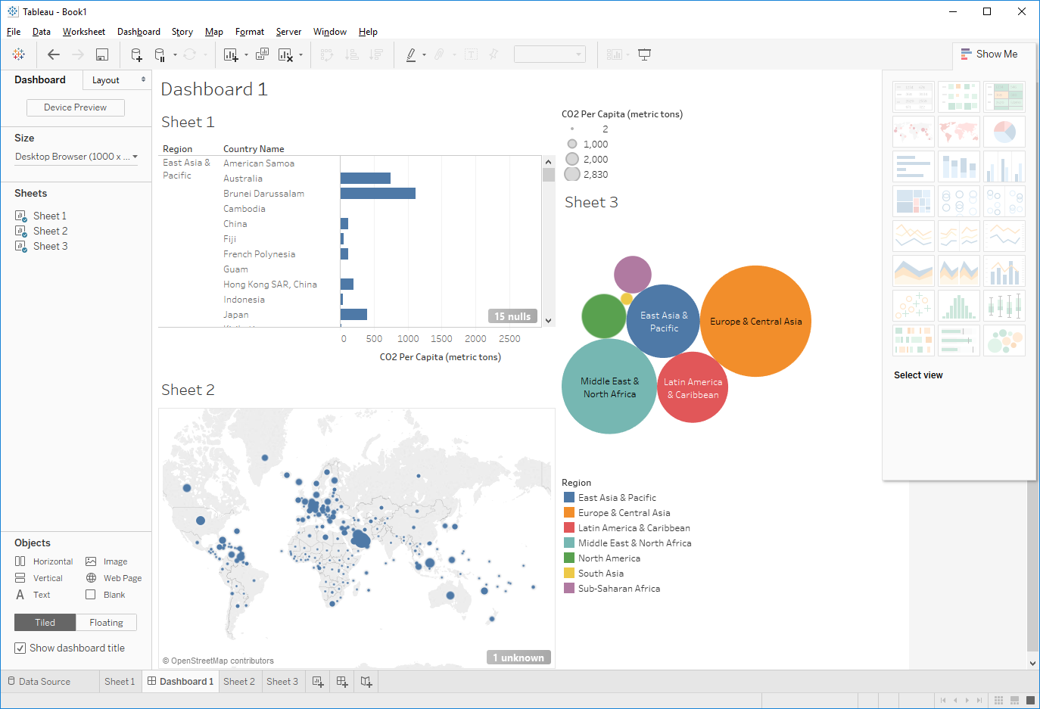
Exercise – Tableau Dashboard
World Bank CO₂ Data (Moodle)
Use “cleaned” data
Set Target
eg, high CO₂ rates
Colour
Design
Publish to Tableau Public

